Slide 1
Use of Green Sand Additives as Essential Contaminants
Mr. Deepak Chowdhary
Founder & Managing Director
MPM Pvt. Ltd., India
Manufacturer of Lustrous Carbonaceous Additives

Slide 2
A Perspective on Additive Control in Molding Sand
Raw Sand
The most refractory material in the sand mold
Bentonite
The most cost effective high temperature, sustainable binder for the raw sand
Ancillary Additives
Water
Coal Dust
Essential to activate the gelling/binding properties of Bentonite
Most effective low cost Lustrous Carbon de-oxidant to help prevent sand-metal reaction
Dextrin, Wood Flour, etc., used based on the specific requirement
Principal additives used for preparing Sand Molding
The straight forward objective of this simple mix is to prevent Metal-Mold reaction
“However, this simple mix of these 4 basic additives becomes complex when exposed to the dynamics of the circulating system sand of a foundry”

Slide 3
The Need for the Perspective on Additive Control
MAJOR EFFECT OF MORE THAN NECESSARY USE OF ADDITIVES
Increase in Total Surface Area (TSA) of the Total Sand
Uneven Compaction
of the Mold
Increase in Moisture Demand/Temper Water
Reduced Permeability
The Big ?
Lower Flowability of Sand
Increased Sand Sticking
What is the Optimum Additive Consumption?
Lowering the Fusion Point of the Molding Sand/Reduced
Sand Refractoriness

Slide 4
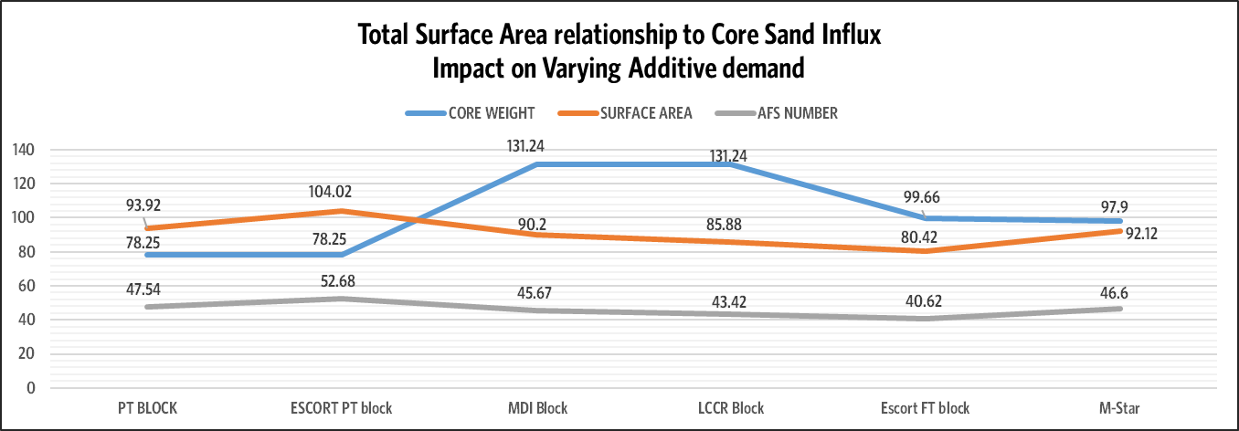
Challenge of Using Optimum Level of Additives
Varying Product Mix
Return Sand Measurements – the ARBITRAGE GAP
Varying Total Surface Area of Sand
Return Sand Hopper
Return Sand
Cycles and
Resultant Layers in
the Return Sand
hopper
Inter-relationship Between Sand Properties
Varying Core sand Influx
Multivariate Cause and Effect Between Sand Parameters and Additives
Impact on Casting Defects
Reactive Decision on Additions

Slide 5
Effect of Interrelationship Between Sand Properties
The change in any property can impact several sand properties simultaneously
*PARAMETERS | INCREASE | MOISTURE | COMPACTABILITY | ACTIVE CLAY | GCS4. Slide 4 | PERMEABILITY | INERT FINES | LOI | WTS | SHEAR STRENGTH | SHATTER INDEX | GFN | SPECIMEN WEIGHT | FRIABILTY INDEX
TEMPER MOISTURE | ↑ |  | ↑ | X | ↑ | X | X | X | ↑ | ↑ | ↑ | X | ↓ | ↓
ACTIVE CLAY | ↑ | X | ↑ |  | ↑ | ↓ | X | X | ↑ | ↑ | ↑ | ↓ | X | ↑
Legend
Direction
Increase
Decrease
No Change
Likely
*Table is a partial list of sand parameters

Slide 6
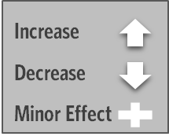
Impact of Additives & Interrelationship Between Sand Properties
ADDITIVES | Increase | GCS | Shear Strength | Shatter Index | Moisture % | Wet Tensile Strength | PH Value | Permeability | Specimen Weight | Compactability | Friability | L O I | V M | Active Clay | Inert Fines | AFS No.
SODIUM BASE BENTONITE | ↑ | ↑ | ↑ | ↑ | O | ↑ | ↑ | ↓ | ↑ | ↑ | O | X | X | ↑ | O | X
LUSTROUS CARBON ADDITIVE | ↑ | ↓ | ↓ | ↓ | X | ↓ | ↓ | ↑ | ↓ | ↓ | ↑ | ↑ | ↑ | X | X | O
FRESH SILICA SAND - HIGH GFN NO. | ↑ | O | O | O | O | O | X | ↓ | ↑ | O | O | X | X | X | X | ↑
Active Clay
Compactability
WTS
Inert Fines
Decrease in Bentonite
GSS
GCS
Control
Sand Parameters
Moisture
Shatter Index
Friability
Specimen Weight
pH value
Permeability

Slide 7
TSA – Total Surface Area of Molding Sand
“By far, the most important and overlooked impactor of variation in green sand preparation, is the Total Surface Area (TSA) of the molding sand”
Reasoning: each pattern return sand will form a layer as it re-circulates into a storage hopper
The TSA of sand layer for the next molding batch mix can only be estimated
The motivation is to examine the variability of the TSA of the sand before it goes into the mixer
The variability will decide how much make-up additives are required to achieve target properties
Core Sand Infiltration at varying percentage affects molding sand GFN; thereby TSA

Slide 8
Impact of Increased/Decreased Additive demand
Impact on flowability of the system sand:
All additives, while imparting essential properties to the molding sand, essentially also serve to reduce/increase its flowability
Flowability is a crucial KPI of the molding sand as it enables/inhibits the delivery of the sand to all edges, corners and contours of the cavity
Lowers the fusion point of the molding sand and reduces sand refractoriness:
None of the additives added to the molding sand have the fusion point of the silica sand (1650-1750 °C)
Additives like Bentonite lead to lowering the sintering point of the sand
Increased levels of active clay are empirically associated with increased sand-sticking and ‘burn-on’
”Most importantly, overdosing additives increases inert fines build up”

Slide 9
Outlook of Additives on Inert fines build up
Inefficient, poor-quality or of additives
Higher additions of Bentonite and Coal Dusts (OVERDOSING)
Increased burn outs and buildup of Inert Fines
Inert Fines ~ 3-4 %
Helps in Smoothening out the free moisture
Helps in development of the adjoining active bentonite particles
Empirical Relationship
Inert Fines > 3-4 %
Increased obliteration, friability and explosive penetration
The dust collector extraction will not be limited to the dead fines due to burn outs of the additives but also the fines of active bentonite and un-burnt carbonaceous dusts.
These are never fully refluxed back into the circulating sand due to reasons of their GFN which can upset the total surface area balance further compounded by handling issues like air pollution, from the POC (Point of Collection) to the POU (Point of Use).

Slide 10
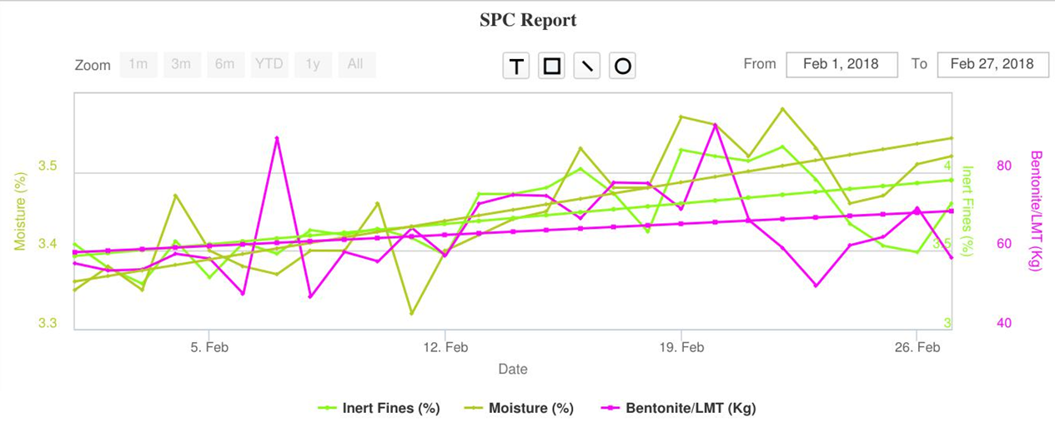
Bentonite Impact on Moisture Demand and Inert Fines
The increase/decrease in the surface area of the system sand is the corresponding increase/decrease in the moisture demand and temper water point.
Courtesy : SANDMAN

Slide 11
Impact of Bentonite on Casting Surface Finish
Beyond optimum use of Bentonite more often than not, leads to sand sticking and sand fusion on the casting surface (example: lower sintering point of the Bentonite, increase in Inert Fines and Moisture demand)
Courtesy : SANDMAN

Slide 12
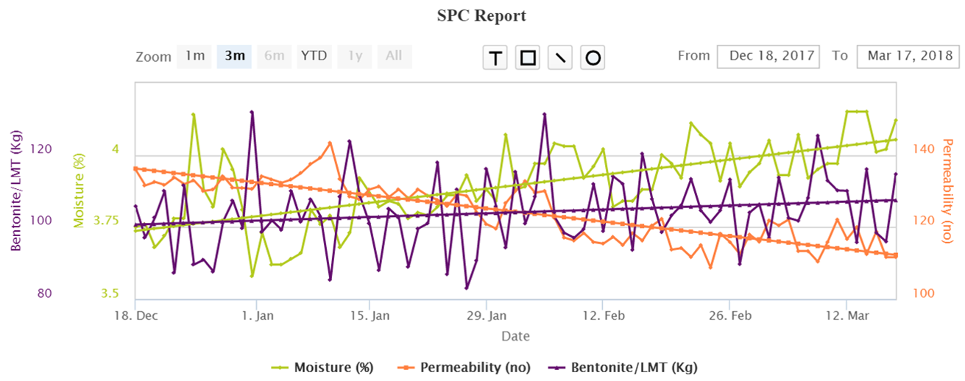
Impact of Bentonite on Permeability
Higher additions of additives, clay and starch leads to reduced permeability with possible related risk of blow hole defects.
Courtesy : SANDMAN

Slide 13
What is the optimum additive consumption?
Data Analytics & Decision Support
Domain & legacy based Human Expertise
Additives Source & Quality based on Key Performance Properties
Optimal
“The use of data science and analytics is the scientific answer to predict the precise optimal points for each sand property, based on the inter-relationship between sand parameters and also co-related to casting defects (scrap)”

Slide 14
How should optimum additive consumption be monitored?
Monitor the TSA for variability of additive demand. This is the pulse for all additive demand.
Avoid over/under dosing of Active Clay/Lustrous Carbon/Water etc., by always taking into account the inter-relationship between sand properties before reacting with dosage or source or quality change
Always choose additives based on their KPI :
Consider the purpose the KPI has to serve and then its cost
Establish Additive KPI beyond conventional tests. There is always something more that you should know. Seek expert help, read widely and go deep into understanding the additives (example: bentonite or coal dust).

Slide 15
Summary : Benefits of Using Additives with the perspective of being essential contaminants
Adds significant and competitive value in terms of:
Cost saving when added in variable and optimal quantities, co-related to varying casting product mix, source and quality.
Re-claiming repetitive lost profits by improving process consistency thereby
achieving reduced, related casting rejections
optimized additive consumption.
Improving Casting productivity & quality of surface finish
Maintaining a dynamically sustainable, stable and scalable balance in sand control process consistency

Slide 16
MPM INFOSOFT and the SANDMAN Team wish to thank
World Foundry Organisation, Polish Foundrymen’s Association, 73rd WFC and the
Distinguished Leaders of the Foundry Industry
for the invaluable opportunity to address and present ‘Use of Green Sand Additives as Essential Contaminants’.

